Slide 1
Is the current discount policy justified in terms of profit maximization?
Tomasz, Sruthi, Baris • 02.04.2026

Slide 2
Strategic Analysis: Discount Impact & Revenue Optimization
Balancing Customer Acquisition with Long-term Profitability
The Strategic Conflict:
Marketing View: Discounts drive acquisition and retention.
Investor View: Concerns over declining revenue despite higher order volumes.
The Core Insight:
Seasonality is Key: Revenue surges are driven by dates (Black Friday/Christmas), not by higher discount percentages.
Our Recommendation:
Optimize Marketing: Invest on some point more into advertising during peak hours and seasons.
Protect Margins: Focus discounts only where they actively boost conversions.

Slide 3
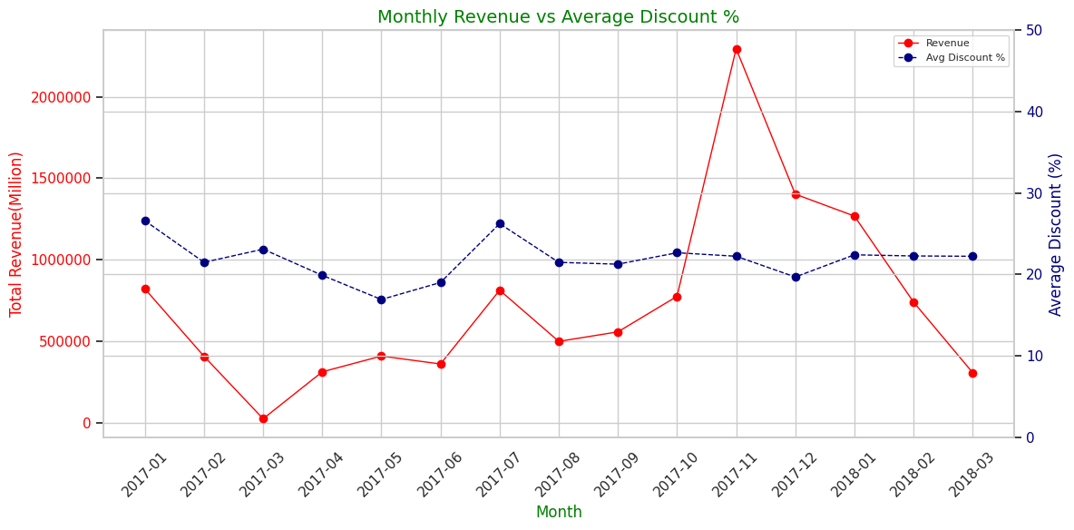
The increase in revenue during the Black Friday and Christmas period indicates high purchasing activity during this time.

Slide 4
Marketing Campaign
Needed!
Why?: Discount Policy does not work properly!
Discount amount vs revenue: correlation = 0.12
The correlation is slightly positive but very small.
This basically means there’s almost no relationship – higher absolute discounts (in currency) don’t significantly increase or decrease revenue in your dataset.
The impact of the discount amount is therefore minimal.
Discount percent vs revenue: correlation = -0.35
The correlation is moderately negative.
This means that the higher the discount percentage, the lower the unit revenue, which makes sense – bigger percentage discounts reduce the selling price.
It’s not a very strong relationship (-1 would be perfectly negative), but the trend is noticeable.
A marketing campaign is necessary before Black Friday and Christmas…. When exactly show our adverts?....

Slide 5
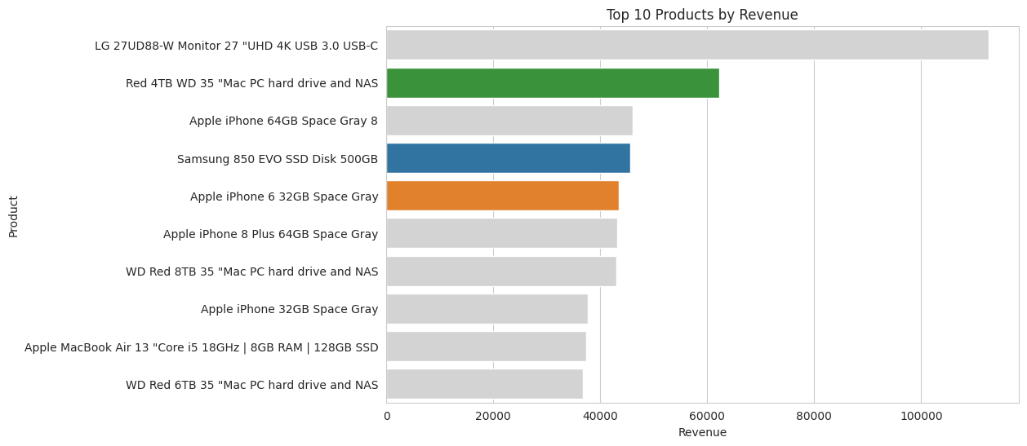
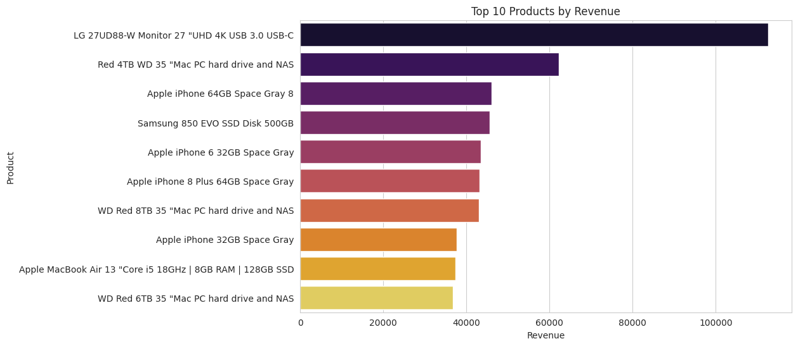
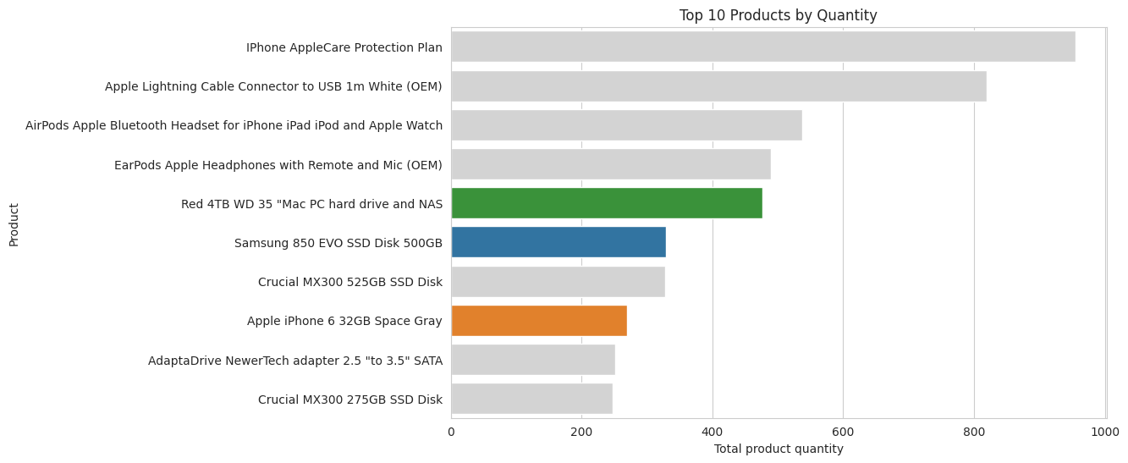
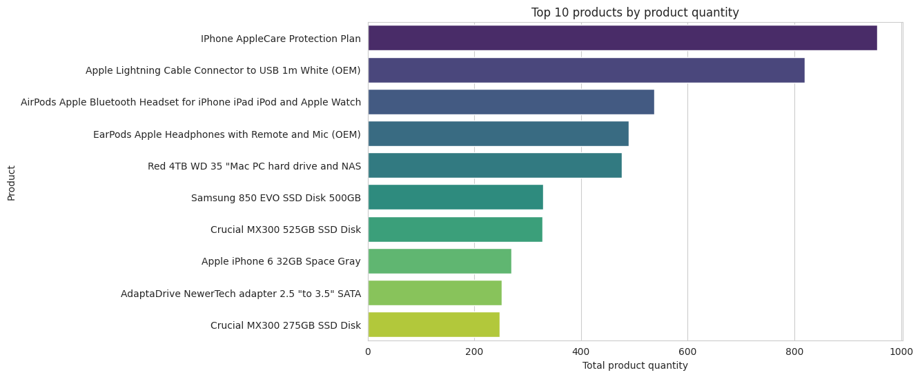
10 Bests Products - Sales overview
“The best-selling products do not align with the most profitable ones. This is not economically optimal.”

Slide 6
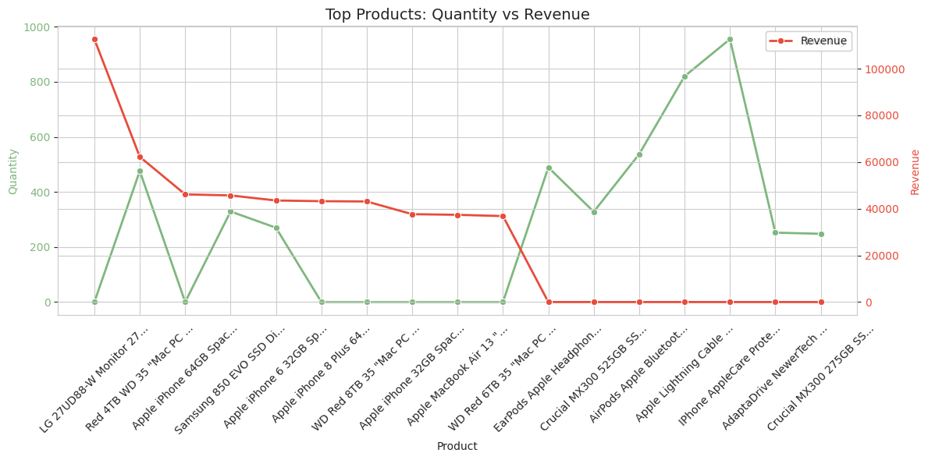
SALES
Where shall be discounts! (red over green)
for products where revenue is higher but sales quantity is lower
Where we shall go up with price to maximize revenue! (green over red)
for products where sales quantity is higher but revenue is lower

Slide 7
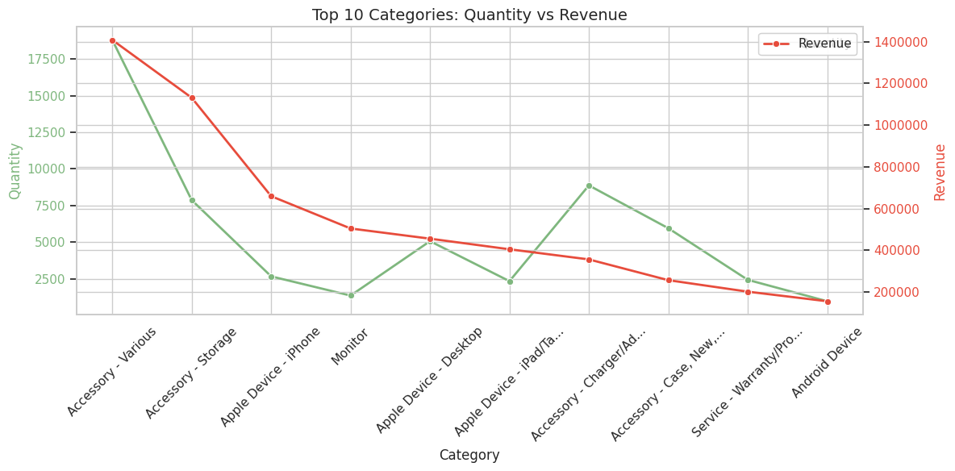
SALES
Where shall be more discounts (red over green)
For product categories where revenue is high but sales volume is low, we should offer discounts.
Where we shall make price Higher to maximize revenue (green over red)
For product categories where sales volume is high but revenue is low, we should raise prices to maximize revenue.

Slide 8
When should we intensify the display of online ads linking to us on other websites?
Before Black Friday and
Christmas

Slide 9
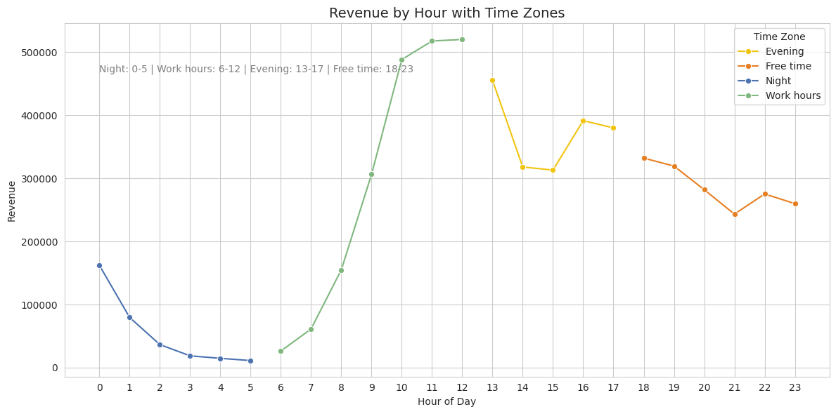
During these hours of the DAY, customers make purchases.

Slide 10
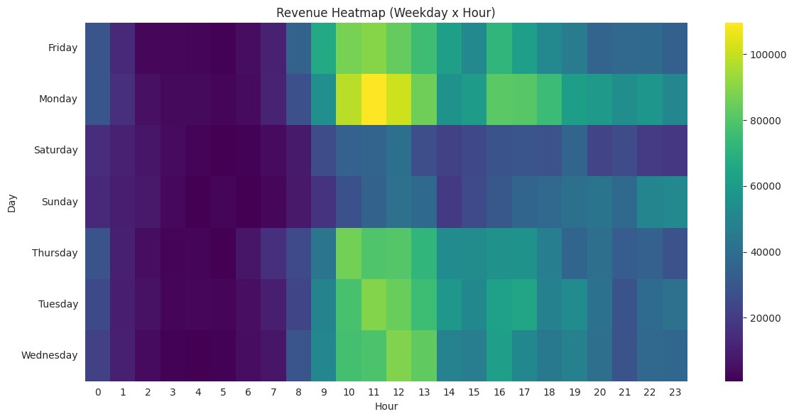
During these hours of the day in WEEK, customers make purchases.
We should purchase advertising space in the form of online banners. The ads must be displayed at the following hours and days of the week. (Yellow)

Slide 11
CONCLUSIONS
1. We need to revise our discount policy to maximize profits.
2. We need to allocate more % of revenue to Marketing to drive sales during key periods (Black Friday and Christmas). This investment is critical for maximizing revenue, not just cutting costs.

Slide 12
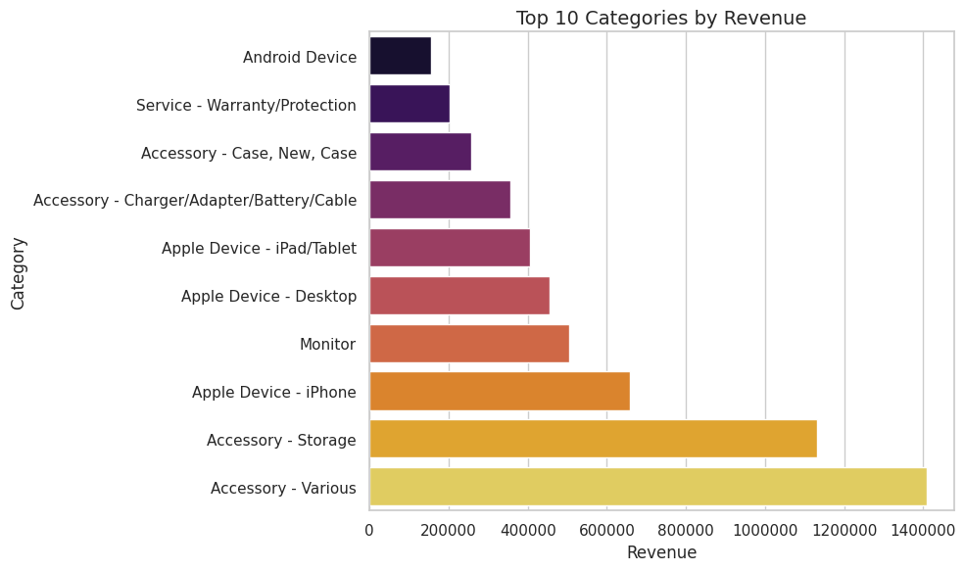
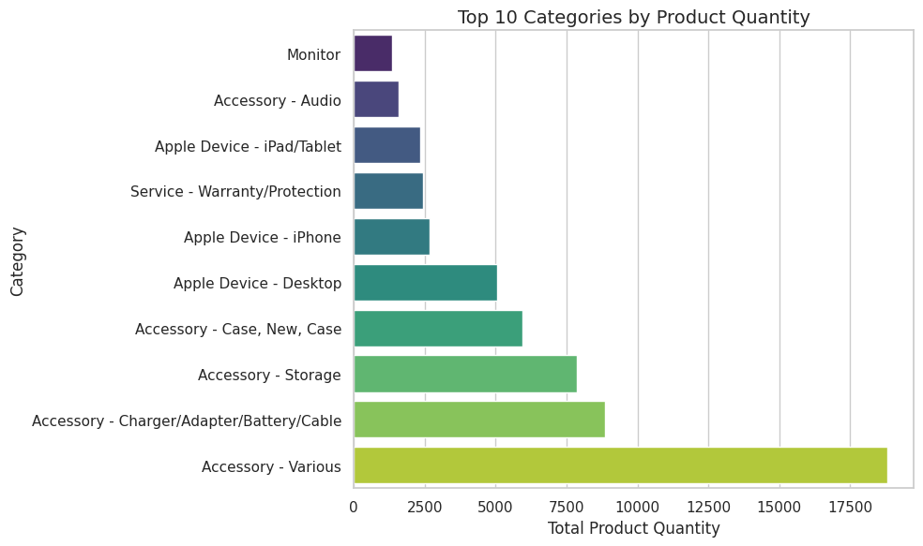
TOP 10 Categories - overview
“Not all of the best-selling product categories align with the most profitable categories.
This is not economically optimal.”

